Slide 1
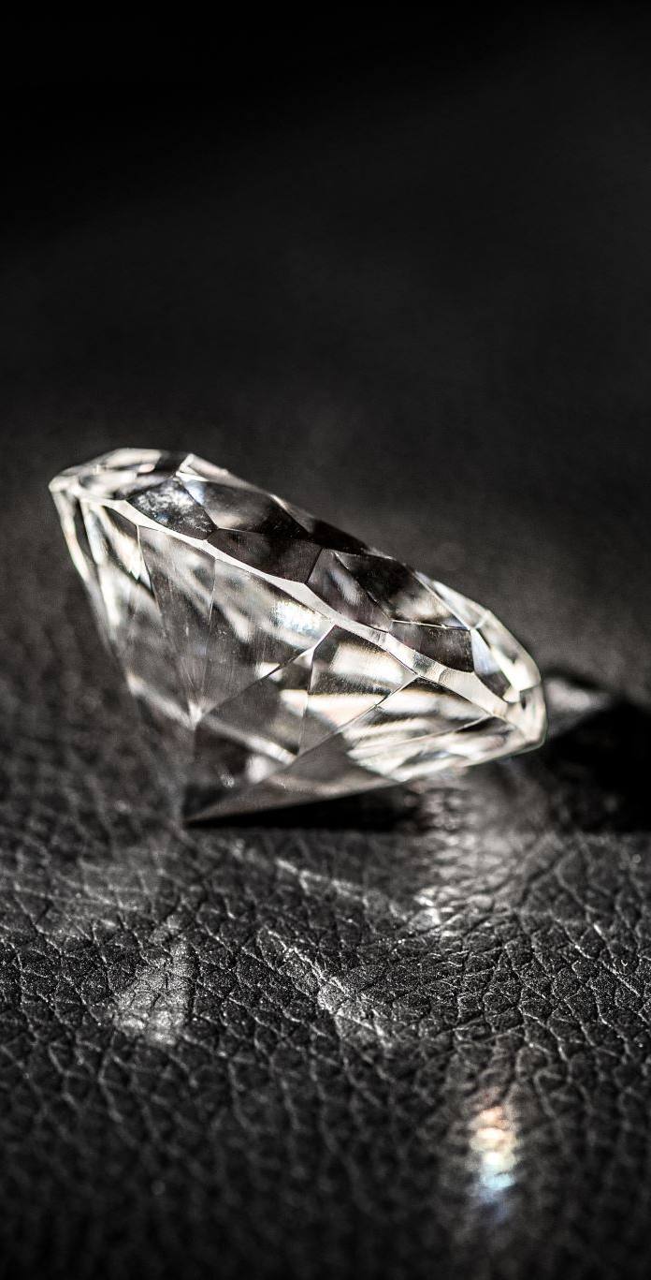
GROUP 13
Pear (0.90-0.99ct)
Adithya Pushpaletha
Pulikandala Sherwin Paul
Kolisetty Kausalya Nandan
Notes:
So the data we collected is of the following range. That is 0.90 - 0.99 in pear shape.
The data for this certain range and shape was difficult to find as there were limited data set available
Well-cut diamonds in the range of 0.90 – 0.99 carat are not common in the market. Due to economic reasons, cutters have the incentives to compromise on cut quality to achieve a poorly cut 1 ct diamond rather than a well cut 0.9 ct diamond.
0.90 cts is a popular choice for those looking to save on a one-carat diamond. Unless someone's measuring your diamond, they'll never know that it's below 1.00 ct, and the jump in pricing at the one-carat mark makes this diamond weight appealing to those looking for savings.

Slide 2
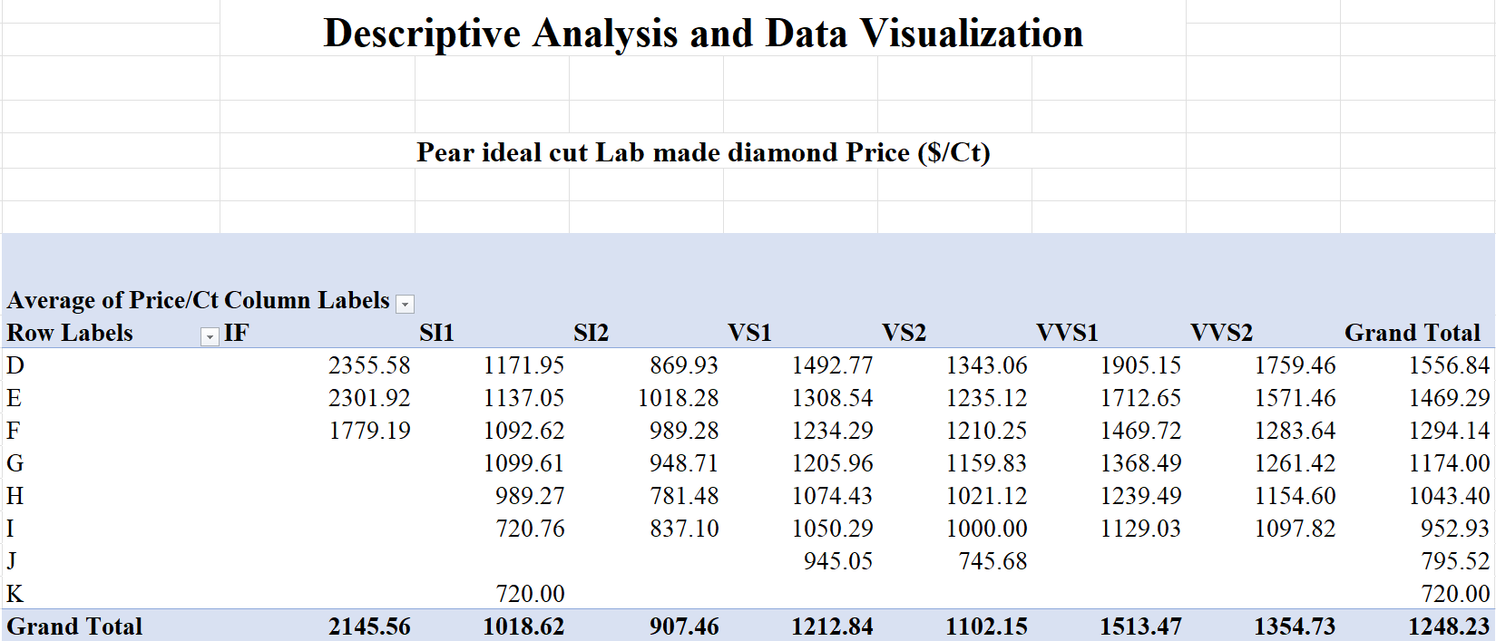
Dependent and Independent Variables
Independent Variable
Dependent Variable
Independent Variable
Notes:
We found a total of 168 data set with a mix of shapes including Pear, oval, emarald, etc Out of the dta collected this is the picvot table we could develop where in the colours act as independent data and the average price of th the dimond acts as dependent data as it changes according to the hsape carat range and colour.

Slide 3
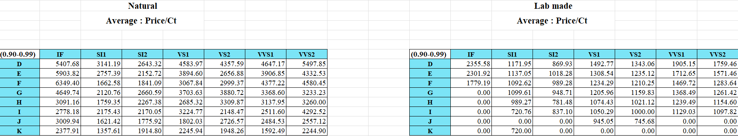
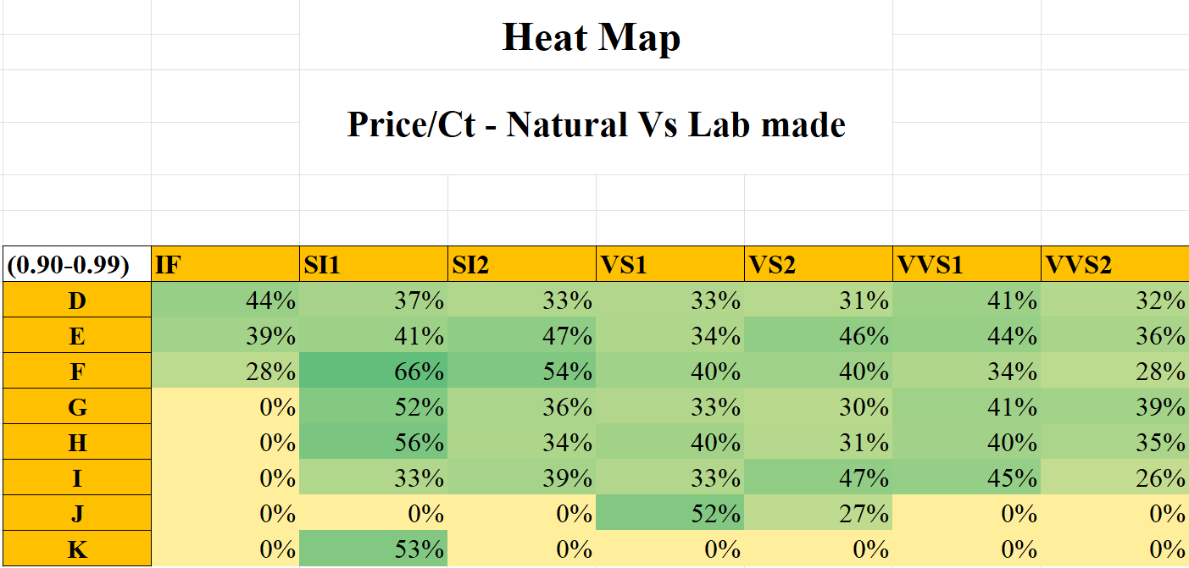
Data Comparison
Notes:
There was a lot limited data available in the clarity IF and and mailny in the colours J k
With data available the prce range did not varry much it falls within a percentage range of 30 – 6- on an aaverage

Slide 4
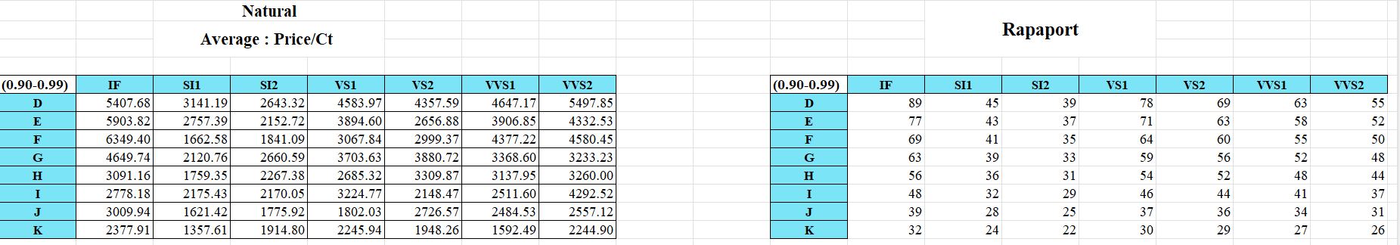
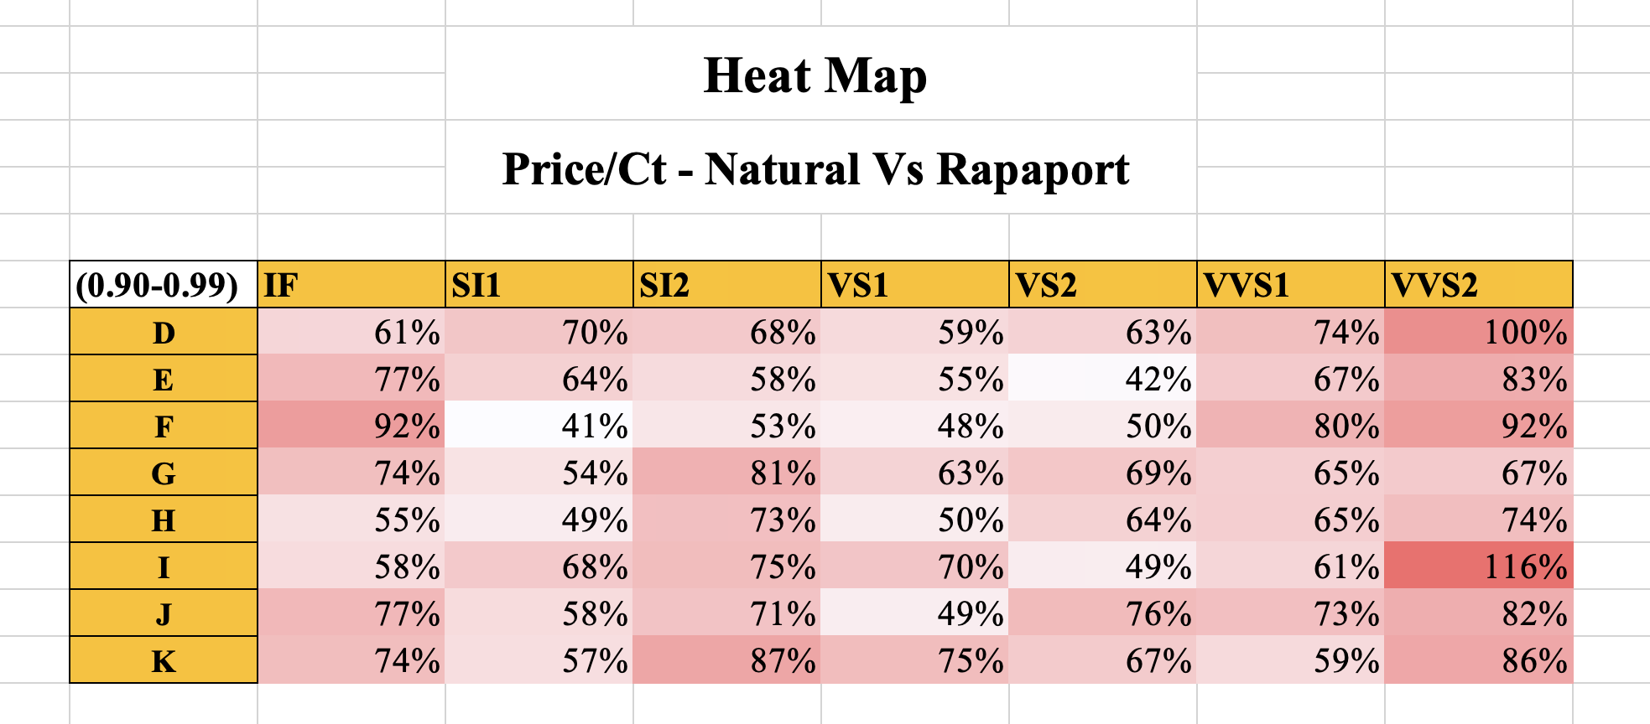
Data Comparison

Slide 5
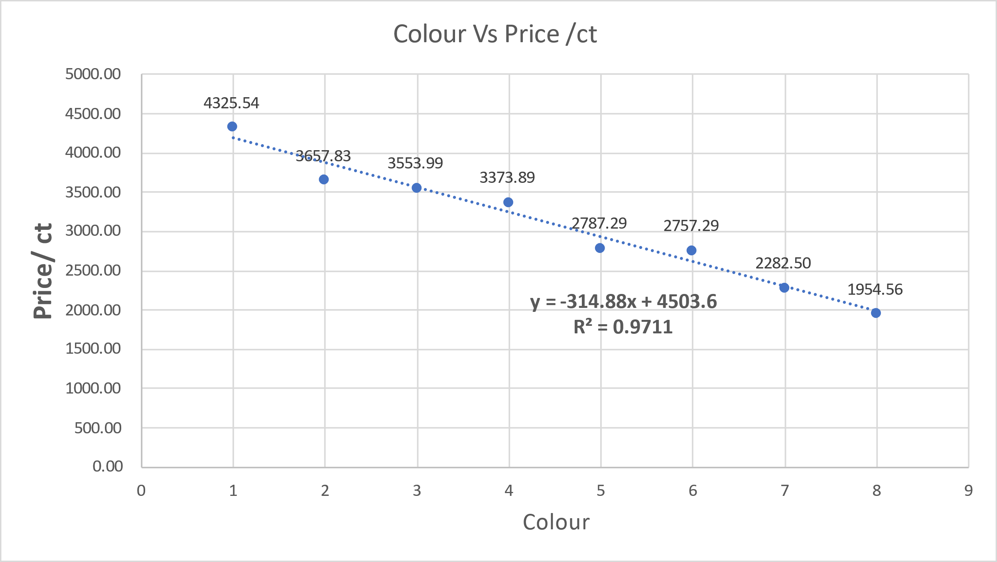
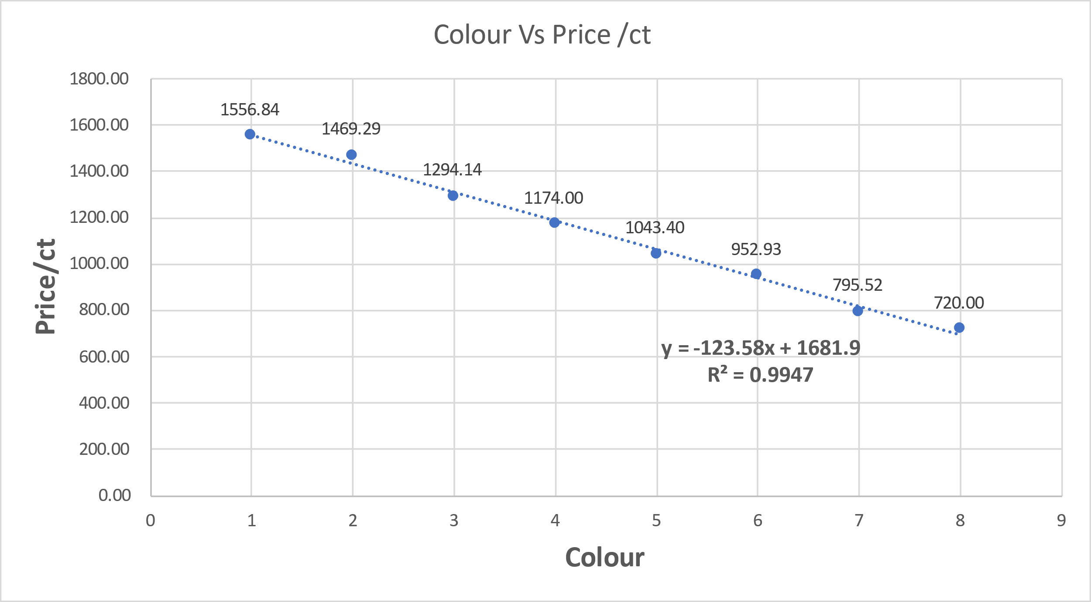
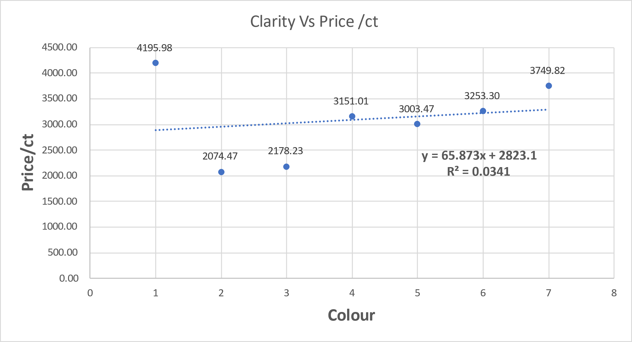
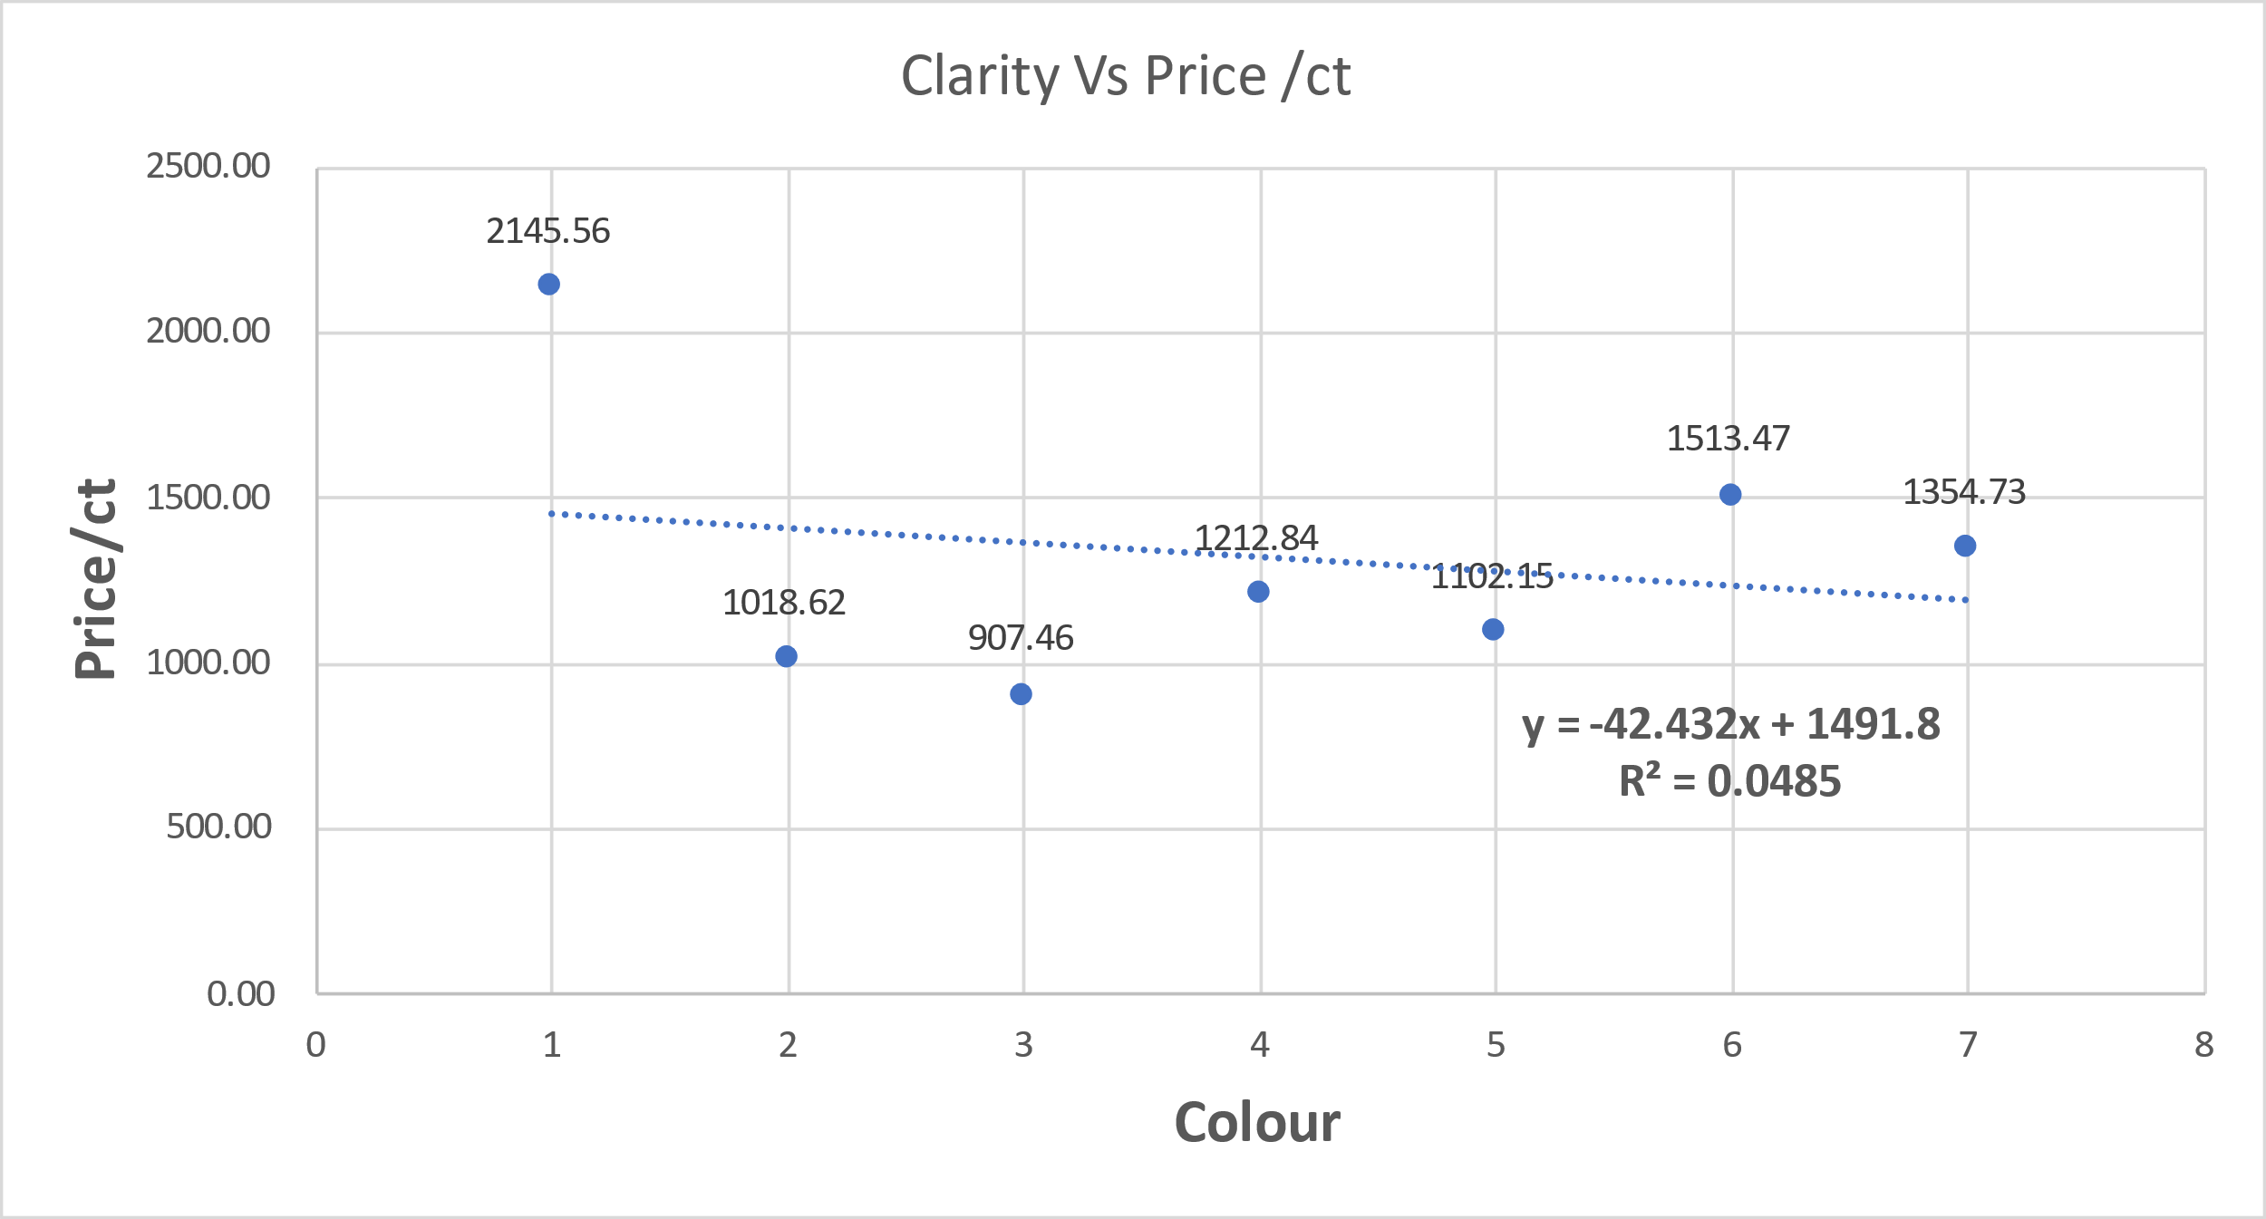
Natural made Lab Made
Notes:
Color vs price/carat
This is the comparison between natural and lab-made and was developed by using color vs price/carat and clarity vs price/carat.so, if u observe the scatter chart, there is a downward trend,as the color goes further the price of the diamond tends to decrease. Regression and R^2 values are found and highlighted in the scatter charts.
Clarity vs price/carat:
The data is a little inconsistent because there is limited data available, therefore the price range tends to fluctuate and it becomes difficuilt to have a consistent trend line. As soon as one dependent factor is changed the price of each color varies significantly.

Slide 6
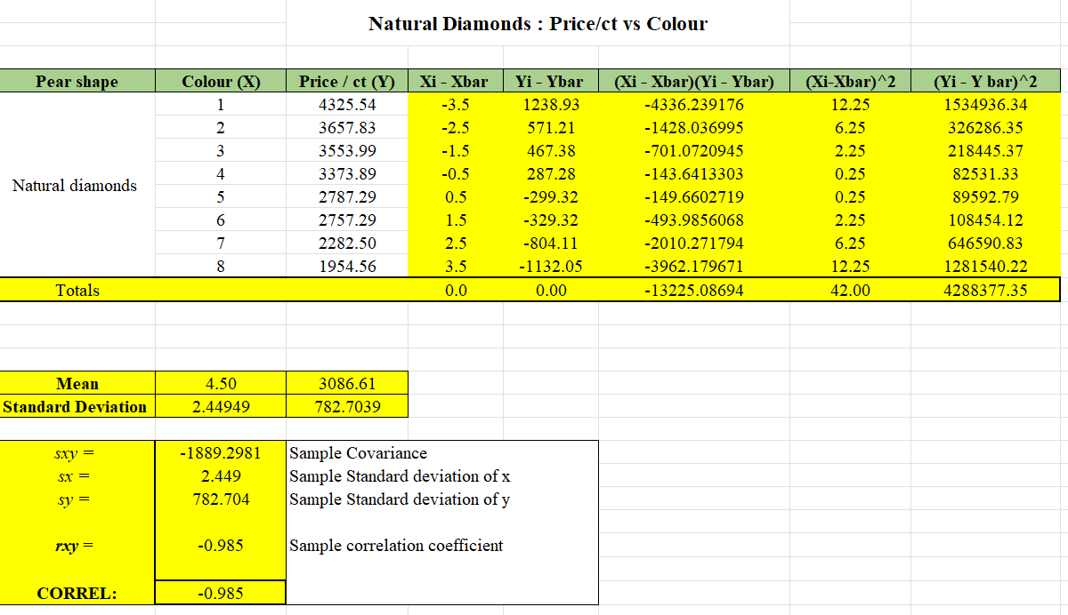
Covariance(Sxy)
Notes:
This is the cov we developed were sample cov of natural diamonds has a negative value that shows a downward trend as mentioned in the scatter chart
The core value comes to – 0.985

Slide 7
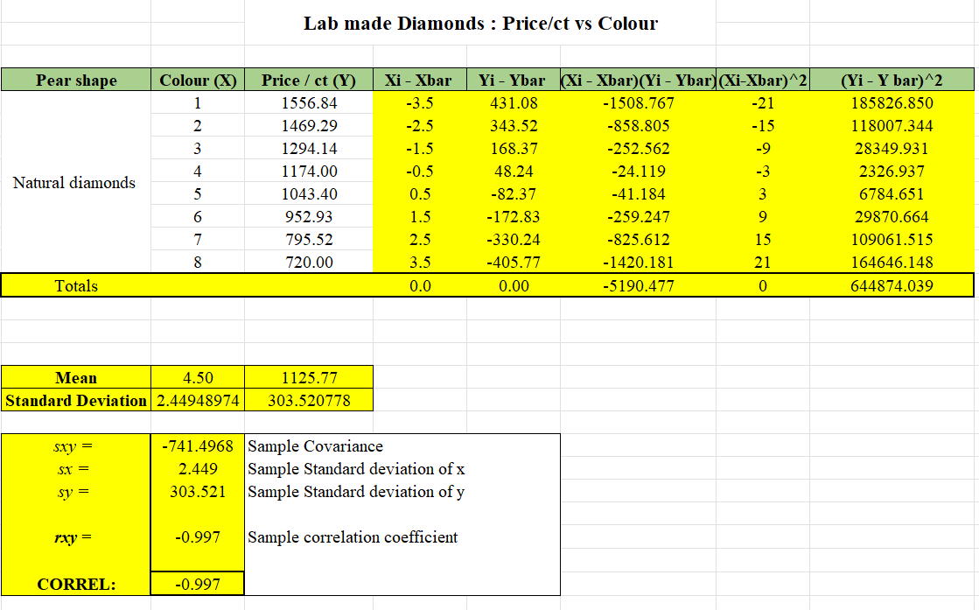
Covariance(Sxy)

Slide 8
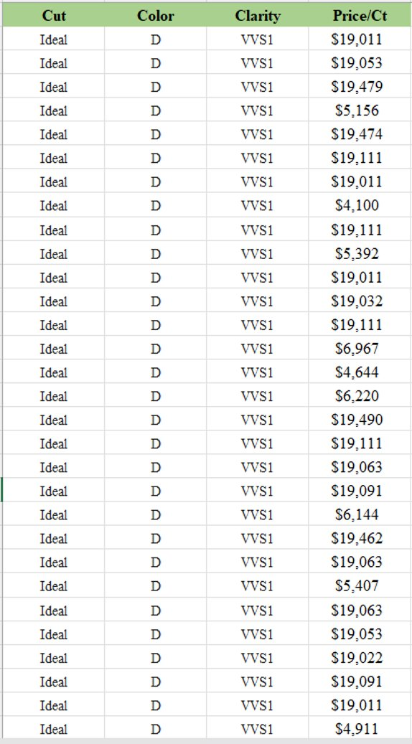
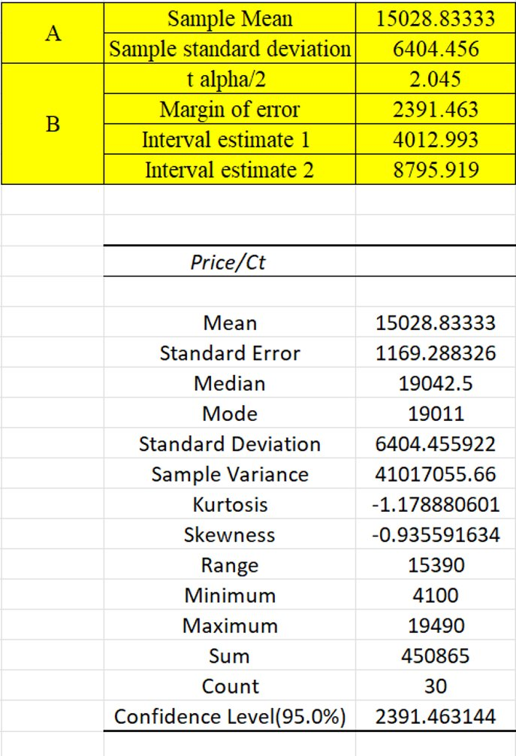
Interval Estimate

Slide 9
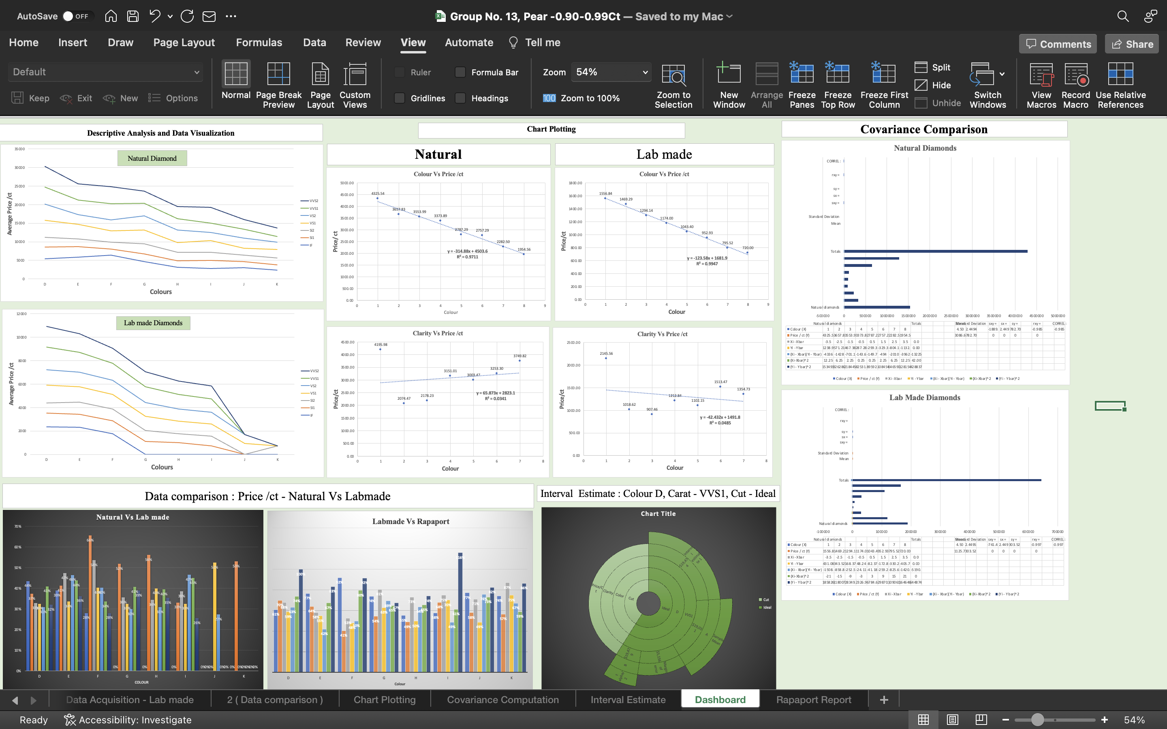
Data dashboard

